Slide 1

DEPARTMENT OF ELECTRONICS AND COMMUNICATION ENGINEERING
TEAM MEMBERS:
ARUNDHATHI.M 113321106006
KANMANI.S 113321106040
NARMATHA.S 113321106059
DINOSIYA MARY.A 113321106023
JAYASHREE.E 113321106037

Slide 2

ENERGY CONSUMPTION

Slide 3
PROBLEM STATEMENT:-
The measurement of energy consumption is critical in understanding and optimizing energy usage in various sectors, including manufacturing sites, homes, commercial buildings, and transportation. However, the manual collection and analysis of energy consumption data can be time-consuming and error-prone. Therefore, there is a need for an automated approach to collect, analyze and visualize energy consumption data for better decision-making.
PROBLEM DEFINITION:-
The problem at hand is to create an automated system that measures energy consumption, analyzes the data, and provides visualizations for informed decision-making. This solution aims to enhance efficiency, accuracy, and ease of understanding in managing energy consumption across various sectors.

Slide 4
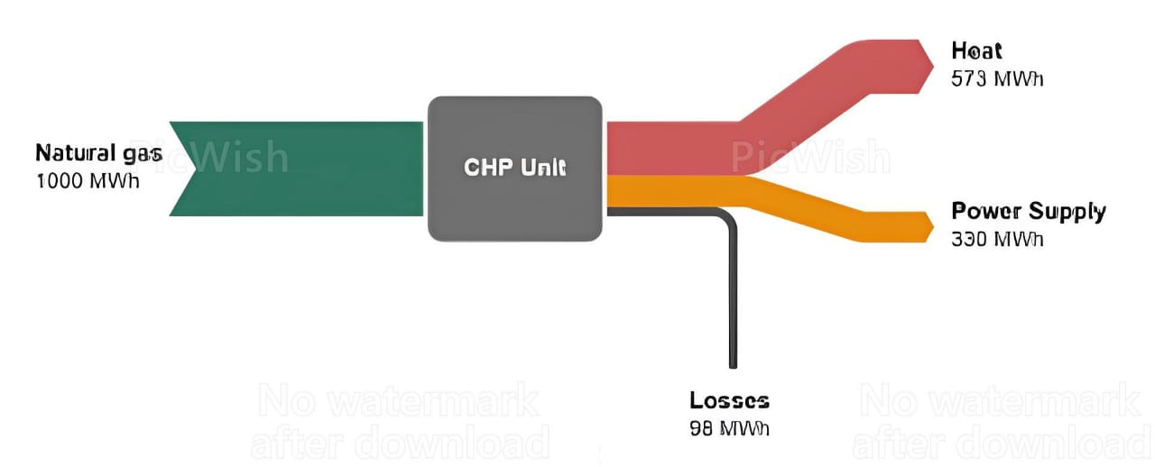
OBJECTIVE:-
In order to promote sustainable economic development and environmental protection, energy efficiency has been widely acknowledged as a top priority for international organizations, governments, firms, and even households across the world
Select Measurement Tools: Choose the appropriate instruments or sensors for your specific application. This might include smart meters, energy monitors, data loggers, or even software solutions.
Data Collection: Collect energy consumption data over a defined period. Ensure that the data is accurate and comprehensive, covering all relevant sources of energy use.
Data Analysis: Analyze the collected data to identify patterns, trends, and anomalies in energy consumption.

Slide 5
TECHNIQUE:-
Energy-efficient appliances: Upgrade to energy-efficient appliances and lighting, such as LED bulbs and Energy Star-rated devices.
Insulation: Improve insulation in your home to reduce heating and cooling energy needs.
Renewable energy: Invest in solar panels, wind turbines, or other renewable energy sources to generate clean power.
Education and awareness: Educate individuals and organizations about the importance of energy conservation.
Energy-efficient lighting: Install sensors and timers for lighting control in commercial and residential buildings.
Waste heat recovery: Capture and reuse waste heat generated in industrial processes.

Slide 6
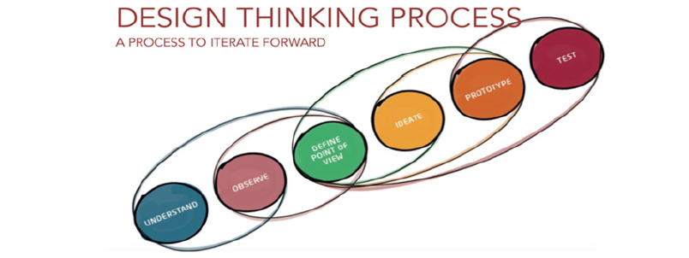
DESIGN THINKING
The main aim of the study was to identify safe and reliable energy solutions for people living in rural communities . The scope of the research is to promote renewable energy solutions to reduce overdependence on solid fuels for activities such as cooking and lighting.
This phase is that a hybrid renewable energy plant consisting of a central biogas unit and a domestic solar system should be developed for the community.
Biogas would be used for cooking and other thermal applications, and solar energy would be employed for lighting and to recharge batteries.
The design of biogas and solar units will be separately processed through the remaining stages of the Design Thinking methodology and reported in a future communication

Slide 7
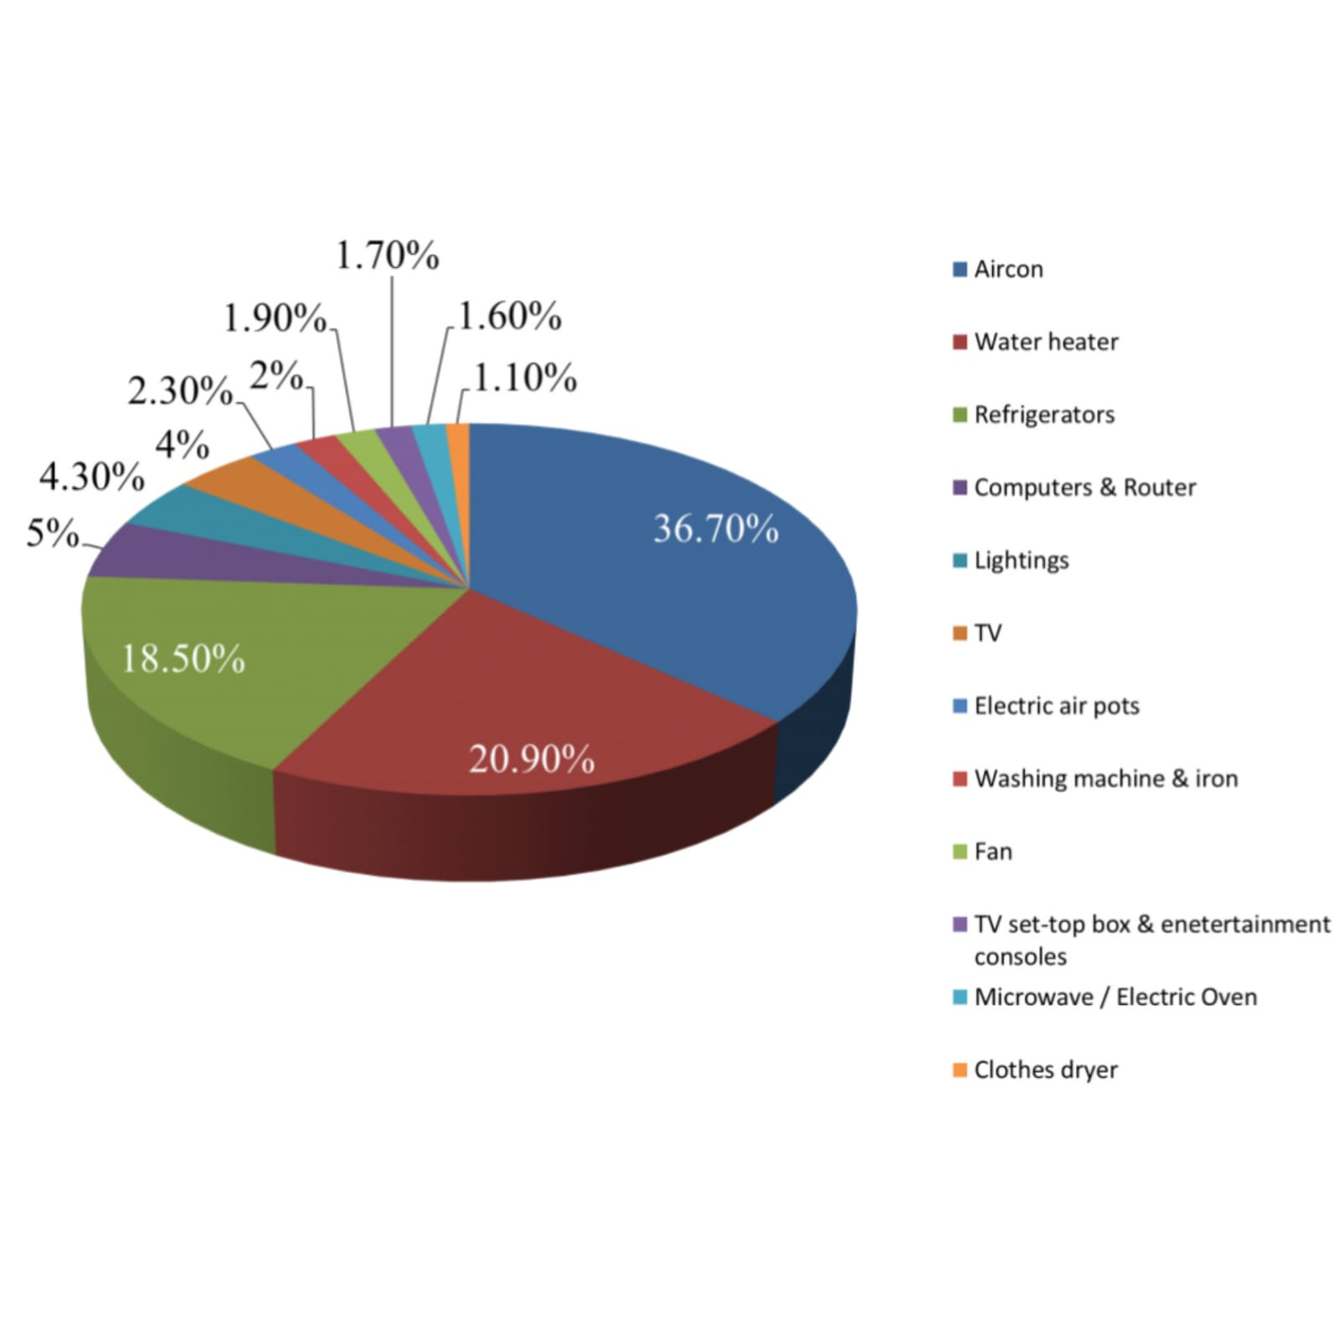
VISUALIZATION:
Pie charts will be useful in comparing the energy consumption of different departments of your business, where the sum of each part will equal to a whole.
They are easy to read and with a quick scan of the chart, you can understand which area of your site uses the most energy and which area uses the least. It is also good practice to ensure you include percentage labels, as the portions of the chart might not be immediately obvious to some stakeholders.

Slide 8
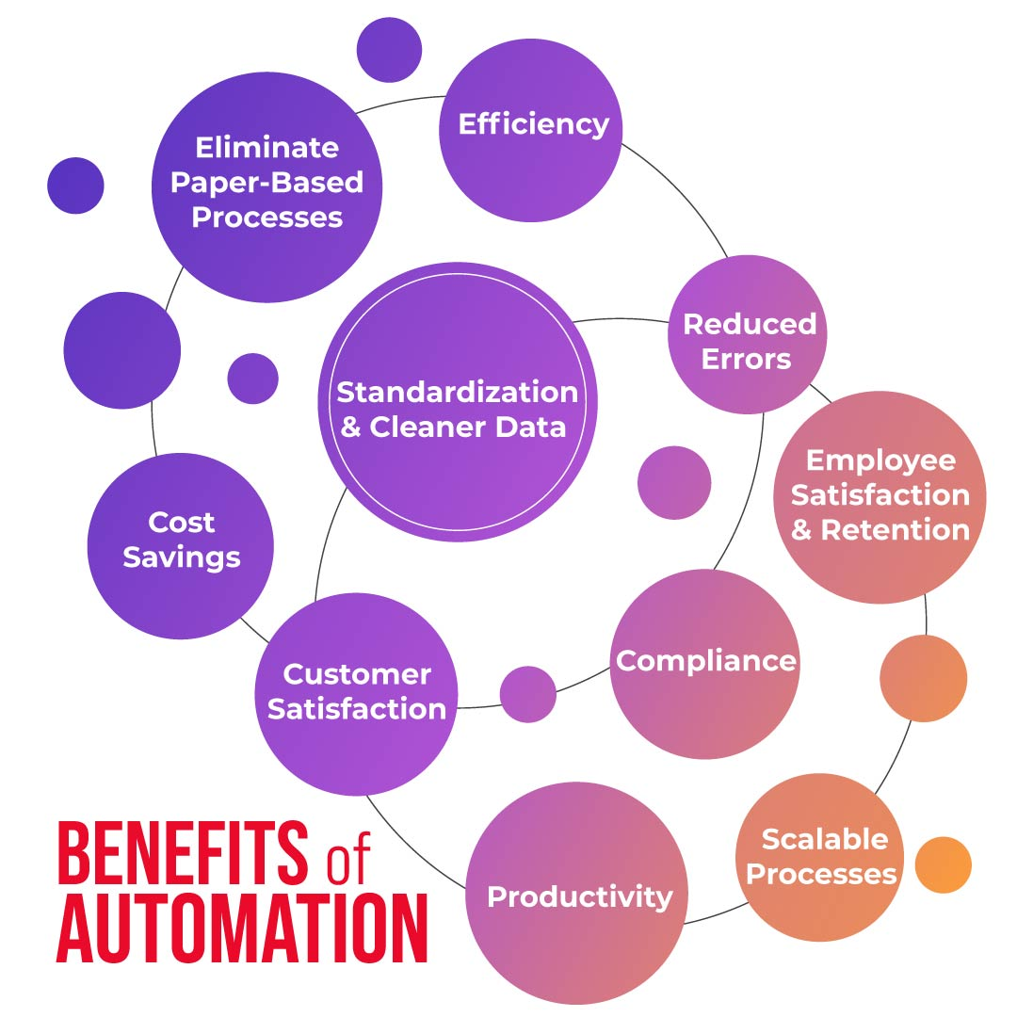
ENERGY AUTOMATION:-
Energy Automation is the convergence of home automation, intelligent energy storage, intelligent breakers and solar technologies all working seamlessly together. Managing energy use and production along with lighting, climate, shades and other home systems is the ultimate smart home!
The benefits of automation include improved accuracy, reliability, and productivity, as well as improved employee morale.

Slide 9
CONCLUSION:-
In conclusion, energy consumption is a critical global issue with far-reaching environmental, economic, and social implications.
To mitigate its adverse effects, it is essential to embrace energy-efficient technologies, renewable energy sources, and sustainable practices.
Government policies, public awareness, and individual actions play pivotal roles in reducing energy consumption and ensuring a more sustainable and resilient future for our planet.

